Slide 1
Concept & Technologies
of Cloud Computing
Cloud Computing: A Hands-On Approach by Arshdeep Bahga and Vijay Madisetti
www.cloudcomputingbook.info

Slide 2
Outline
Virtualization
Load balancing
Scalability & Elasticity
Deployment
Replication
Monitoring
http://www.numericana.com/answer/graphs.htm
Notes:
In this class you will learn the key concepts and enabling technologies of cloud computing. We will introduce and build upon technologies such as virtualization, load balancing, and on-demand provisioning.

Slide 3
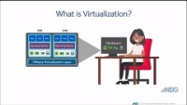
http://www.numericana.com/answer/graphs.htm

Slide 4
Virtualization
Virtualization refers to the partitioning the resources of a physical system (such as computing, storage, network and memory) into multiple virtual resources.
Key enabling technology of cloud computing that allow pooling of resources.
In cloud computing, resources are pooled to serve multiple users using multi-tenancy.
Notes:
Multi-tenant aspects of the cloud allow multiple users to be served by the same physical hardware. Users are assigned virtual resources that run on top of the physical resources.

Slide 5
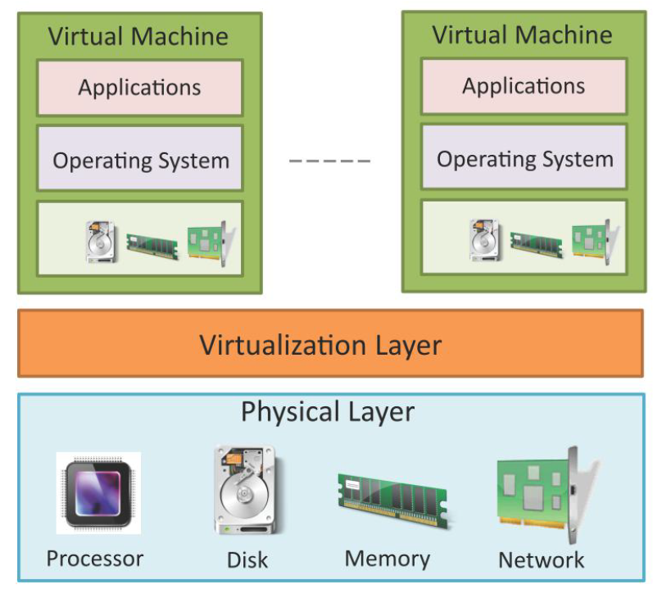
Virtualization architecture
Source: Cloud Computing: A Hands-On Approach by Arshdeep Bahga and Vijay Madisetti
Notes:
This figure shows the architecture of a virtualization technology in cloud computing. The physical resources such as computing, storage memory and network resources are virtualized. The virtualization layer partitions the physical resources into multiple virtual machines. The vitalization layer allows multiple operating system instances to run currently as virtual machines on the same underlying physical resources.

Slide 6
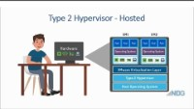
http://www.numericana.com/answer/graphs.htm

Slide 7
Hypervisor
The virtualization layer consists of a hypervisor or a virtual machine monitor (VMM).
Hypervisor presents a virtual operating platform to a guest operating system (OS).
Type-1 Hypervisor
Type-I or the native hypervisors run directly on the host hardware and control the hardware and monitor the guest operating systems.
Type-2 Hypervisor
Type 2 hypervisors or hosted hypervisors run on top of a conventional (main/host) operating system and monitor the guest operating systems.
Notes:
There are two types of hypervisors, Type1 and Type2.

Slide 8
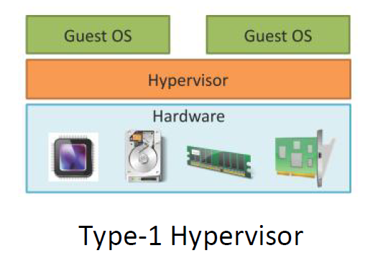
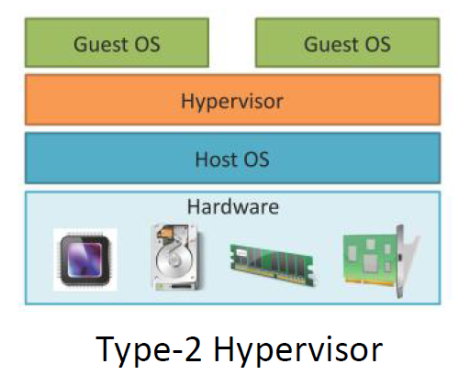
Source: Cloud Computing: A Hands-On Approach by Arshdeep Bahga and Vijay Madisetti

Slide 9
Types of Virtualization
Full Virtualization
In full virtualization, the virtualization layer completely decouples the guest OS from the underlying hardware. The guest OS requires no modification and is not aware that it is being virtualized. Full virtualization is enabled by direct execution of user requests and binary translation of OS requests.
Para-Virtualization
In para-virtualization, the guest OS is modified to enable communication with the hypervisor to improve performance and efficiency. The guest OS kernel is modified to replace non-virtualizable instructions with hyper-calls that communicate directly with the virtualization layer hypervisor.
Hardware Virtualization
Hardware assisted virtualization is enabled by hardware features such as Intel’s Virtualization Technology (VT-x) and AMD’s AMD-V. In hardware assisted virtualization, privileged and sensitive calls are set to automatically trap to the hypervisor. Thus, there is no need for either binary translation or para-virtualization.
Notes:
A guest OS is an operating system that is installed in a virtual machine in addition to the host or main OS. In virtualization, the guest OS can be different from the host OS.
There are various forms of virtualization approaches, full virtualization, para-virtualization, and hardware virtualization. For example, VirtualBox and VMware Workstation are Type-2, Citrix Xenserver, Oracle VM server, KVM, VMWare ESX/ESXi, Microsoft Hyper-V, Xen Hypervisor are Typer-1.

Slide 10
Load Balancing
Cloud computing resources can be scaled up on demand to meet the performance requirements of applications.
Load balancing distributes workloads across multiple servers to meet the application workloads.
The goals of load balancing techniques include:
Achieve maximum utilization of resources
Minimizing the response times
Maximizing throughput
Notes:
One of the important features of cloud computing is scalability. Cloud computing resources can be scaled up on demand to meet the performance requirements of applications. Load balancing distributes workloads across multiple servers to meet the application workloads. With load balancing, cloud-based applications can achieve high availability and reliability.

Slide 11
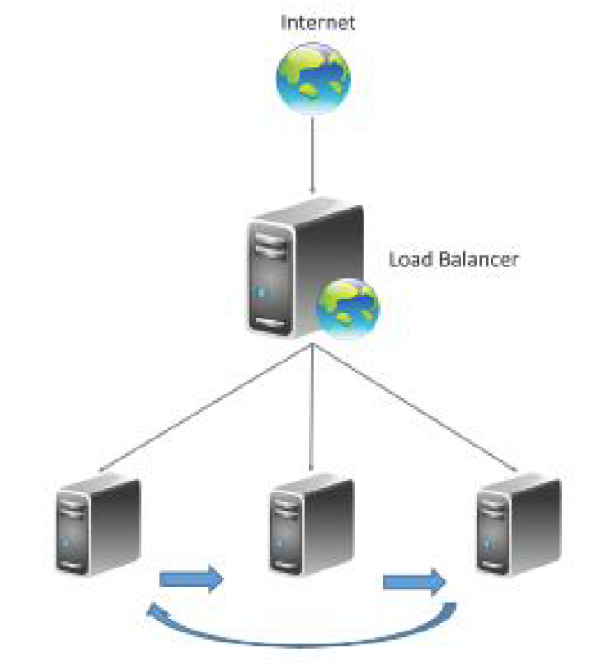
Round robin load balancing
Source: Cloud Computing: A Hands-On Approach by Arshdeep Bahga and Vijay Madisetti

Slide 12
Load Balancing Algorithms
Round Robin load balancing
Weighted Round Robin load balancing
Low Latency load balancing
Least Connections load balancing
Priority load balancing
Overflow load balancing
Notes:
Commonly used load balancing algorithms include: Round Robin load balancing, Weighted Round Robin load balancing, Low Latency load balancing, Least Connections load balancing, Priority load balancing, and Overflow load balancing.

Slide 13
Load Balancing - Persistence Approaches
Since load balancing can route successive requests from a user session to different servers, maintaining the state or the information of the session is important.
Notes:
For session-based applications, an important issue to handle during load balancing is the persistence of multiple requests from a particular user session. Four commonly used persistence approaches are Sticky sessions, Session Database, Browser cookies, and URL re-writing.

Slide 14
Load Balancing - Persistence Approaches
Persistence Approaches
Sticky sessions
Session Database
Browser cookies
URL re-writing
Notes:
Sticky sessions, In this approach all the requests belonging to a user session are routed to the same server. These sessions are called sticky sessions. The benefit of this approach is that it makes session management simple. However, a drawback of this approach is that if a server fails all the sessions belonging to that server are lost, since there is no automatic failover possible.
Session Database, In this approach, all the session information is stored externally in a separate session database, which is often replicated to avoid a single point of failure. Though, this approach involves additional overhead of soring the session information, however, unlike the sticky session approach, this approach allows automatic failover.
Browser cookies, In this approach, the session information is stored on the client side in the form of browser cookies. The benefit of this approach is that it makes the session management easy and has the least amount of overhead for the load balancer.
URL re-writing, In this approach, a URL re-write engine stores the session information by modifying the URLs on the client side. Though this approach avoids overhead on the load balancer, a drawback is that the amount of session information that can be stored is limited. For applications that require larger amounts of session information, this approach does not work.
Load balancing can be implemented in software and hardware. Software-based load balancers run on standard operating systems, and like other cloud resources, load balancers are also virtualized. Hardware-based load balancers implement load balancing algorithms in Application Specific Integrated Circuits (ASICs).

Slide 15
Scalability & Elasticity
Multi-tier applications such as e-Commerce, social networking, business-to-business, etc. can experience rapid changes in their traffic.
Capacity planning involves determining the right sizing of each tier of the deployment of an application in terms of the number of resources and the capacity of each resource.
Capacity planning may be for computing, storage, memory or network resources.
Notes:
Each website has a different traffic pattern which is determined by a number of factors that are generally hard to predict beforehand. Modern web applications have multiple tiers of deployment with varying number of servers in each tier. Capacity planning is an important task for such applications. Capacity planning involves determining the right sizing of each tier of the deployment of an application in terms of the number of resources and the capacity of each resource.

Slide 16
Scaling Approaches
Vertical Scaling/Scaling up:
Involves upgrading the hardware resources (adding additional computing, memory, storage or network resources).
Horizontal Scaling/Scaling out
Involves addition of more resources of the same type.
Notes:
Each website has a different traffic pattern which is determined by a number of factors that are generally hard to predict beforehand. Modern web applications have multiple tiers of deployment with varying number of servers in each tier. Capacity planning is an important task for such applications. Capacity planning involves determining the right sizing of each tier of the deployment of an application in terms of the number of resources and the capacity of each resource.

Slide 17
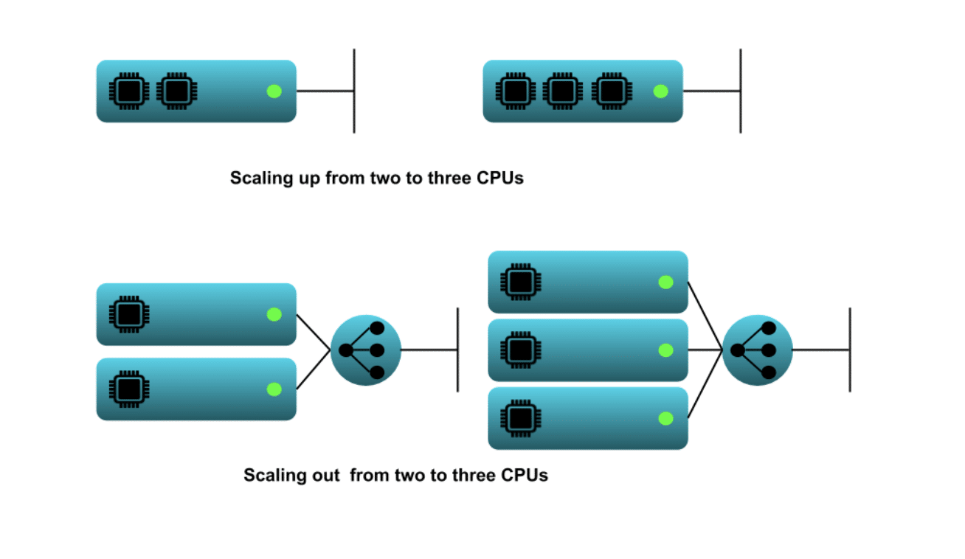
What is Scale up vs Scale out?
Source: Scale up vs Scale out: What’s the difference? | Opsani
Notes:
What is Scale up vs Scale out?
Scaling out, or horizontal scaling, contrasts to scaling out, or vertical scaling. The idea of scaling cloud resources may be intuitive. As your cloud workload changes it may be necessary to increase infrastructure to support increasing load or it may make sense to decrease infrastructure when demand is low. The “up or out” part is perhaps less intuitive. Scaling out is adding more equivalently functional components in parallel to spread out a load. This would be going from two load-balanced web server instances to three instances. Scaling up, in contrast, is making a component larger or faster to handle a greater load. This would be moving your application to a virtual server (VM) with 2 CPU to one with 3 CPUs. For completeness, scaling down refers to decreasing your system resources, regardless of whether you were using the up or out approach.

Slide 18
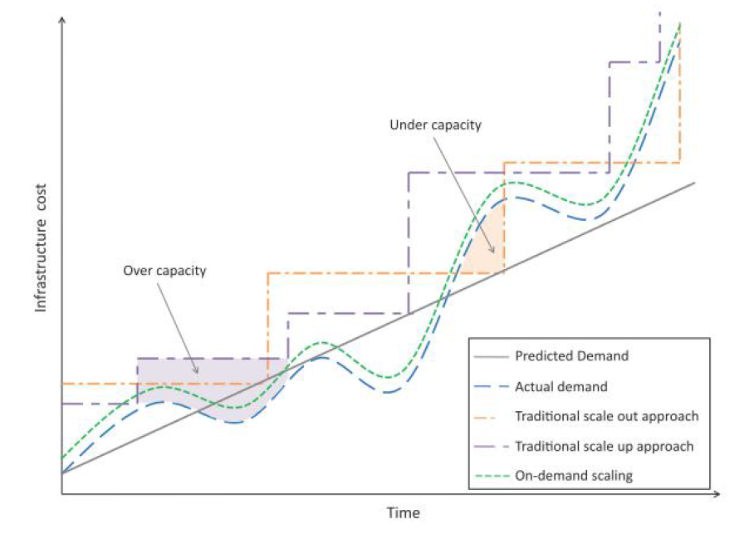
Cost versus capacity curves
Source: Cloud Computing: A Hands-On Approach by Arshdeep Bahga and Vijay Madisetti
Notes:
This figure shows the cost versus capacity curves for traditional and cloud approaches.
Traditional approaches for capacity planning are based on predicted demands for applications and account for worst case peak loads of applications. When the workloads of applications increase, the traditional approaches have been either to scale up or scale out. Scaling up involves upgrading the hardware resources. Scaling out involves addition of more resources of the same type.
From this figure, we can observe that the off-peak workloads are significantly lower than peak workloads. Traditional capacity planning approaches which are designed to meet the peak loads result in excess capacity and underutilization of resources.

Slide 19
Deployment
Cloud application deployment design is an iterative process that involves:
Deployment Design
The variables in this step include the number of servers in each tier, computing, memory and storage capacities of severs, server interconnection, load balancing and replication strategies.
Performance Evaluation
To verify whether the application meets the performance requirements with the deployment. Involves monitoring the workload on the application and measuring various workload parameters such as response time and throughput. Utilization of servers (CPU, memory, disk, I/O, etc.) in each tier is also monitored.
Deployment Refinement
Various alternatives can exist in this step such as vertical scaling (or scaling up), horizontal scaling (or scaling out), alternative server interconnections, alternative load balancing and replication strategies, for instance.
Notes:
The cloud application deployment lifecycle includes deployment design, performance evaluation, and deployment refinement. By comparing performance of alternative deployment architectures, deployment prototyping can help in choosing the best and most cost-effective deployment architecture that can meet the application performance requirements.

Slide 20
Replication
Replication is used to create and maintain multiple copies of the data in the cloud.
Cloud enables rapid implementation of replication solutions for disaster recovery for organizations.
With cloud-based data replication organizations can plan for disaster recovery without making any capital expenditures on purchasing, configuring and managing secondary site locations.
Types:
Array-based Replication
Network-based Replication
Host-based Replication
Notes:
Replication of data is important for practical reasons such as business continuity and disaster recovery. In the event of data loss at the primary location, organizations can continue to operate their applications from secondary data sources. There are three types of replication approaches: Array-based Replication, Network-based Replication, and Host-based Replication.

Slide 21
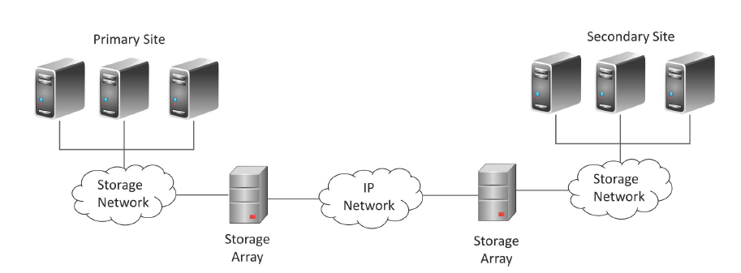
Array-based Replication
Source: Cloud Computing: A Hands-On Approach by Arshdeep Bahga and Vijay Madisetti

Slide 22
Monitoring
Monitoring services allow cloud users to collect and analyze the data on various monitoring metrics.
A monitoring service collects data on various system and application metrics from the cloud computing instances.
Monitoring of cloud resources is important because it allows the users to keep track of the health of applications and services deployed in the cloud.
Notes:
Cloud resources can be monitored by monitoring services provided by the cloud service providers. Monitoring services provide various pre-defined metrics. Users can also define their custom metrics for monitoring the cloud resources.

Slide 23
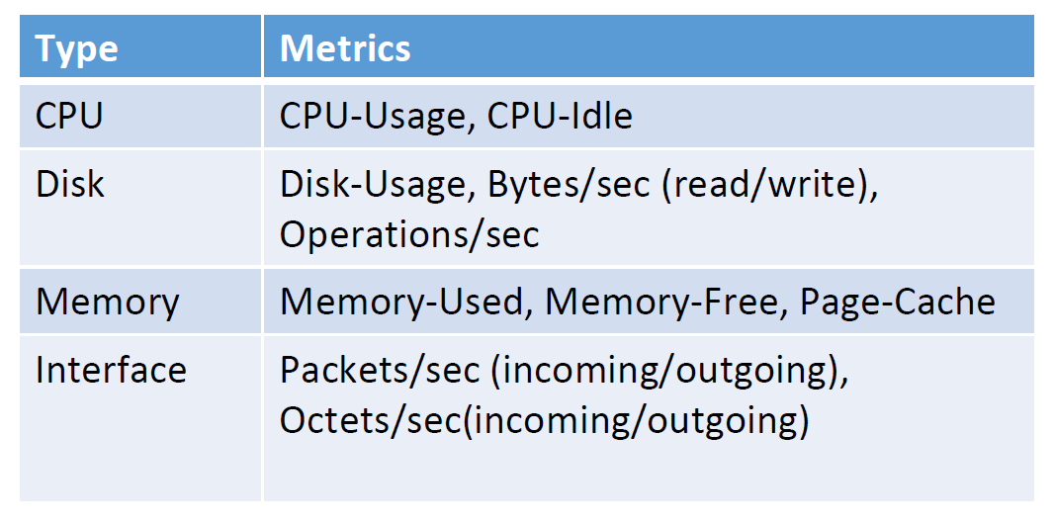
Examples of Monitoring Metrics
Source: Cloud Computing: A Hands-On Approach by Arshdeep Bahga and Vijay Madisetti

